Slide 1

School of Computer Science and Engineering
Department of Computer Engineering and Technology (DCET)
Full Stack Development Project
Panel-X
PRN: 1032232632 Name: Om Jagdeesh PRN: 1032232513 Name: Yashraj Narke
PRN: 1032232588 Name: Lakshya Chanchlani PRN: 1032232531 Name: Jayaram Patel

Slide 2
Problem Statement & Proposed Solution
Problem Statement
Despite advancements in AutoML, many existing systems act as black-box solutions. They lack transparency, offer limited adaptability, and require predefined templates or fixed search spaces. Real-world ML tasks still need human intervention for interpreting data, debugging models, and selecting algorithms. Integrating AutoML into full-stack systems also demands additional custom development.
Proposed Solution
Auto AI Maker introduces an LLM-powered AutoML pipeline using Gemini AI. It dynamically analyzes datasets, generates Python code, executes training scripts, and iteratively refines models.By integrating this agent into a full-stack system using Express, React, and tRPC, the platform provides a flexible, transparent, and autonomous ML model creation experience.This solution bridges the gap between rigid AutoML frameworks and human-like adaptive reasoning.

Slide 3
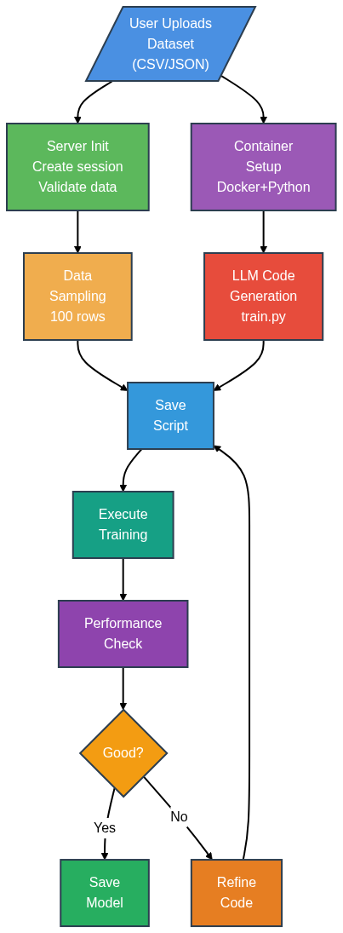
Process Flow Diagram & System Architecture
Step 1: User uploads a CSV file.
Step 2: The Node.js server verifies the uploaded file.
Step 3: The server sets up an isolated Python environment using uv.
Step 4: An AI Agent is created with tools to manage the environment (e.g. write_file, install_dependencies).
Step 5: The server sends the top 100 rows of the CSV to the LLM.
Step 6: The LLM analyzes the sample to decide which AI model best fits the task.
Step 7: The LLM generates a Python script, writes it to the environment, installs dependencies, and runs it.
Step 8: The Python script trains an AI model and measures its accuracy.
Step 9:
If accuracy is acceptable → the model is saved.
If not → the process restarts from Step 6

Slide 4





Technical Stack with Reasoning
Tech Stack
Frontend: React (Vite ) for responsive UI
  Delivers a fast, responsive user experience that hides complicated AI Logic
  Uses Tanstack Router for routing and Tailwind for Easy Styling
Backend: Express + tRPC for type-safe communication
  Runs on NodeJS Runtime handling I/O Operations
  Uses Prisma as ORM for connecting to Database
AI Models: Gemini for intelligent decision-making
  Uses Langchain package for creating Intelligent AI Agent
  Uses Agentic tools like write_file, install_depdendencies
Data Pipeline: Handles dataset transformation and output generation
  Sends First 100 rows of dataset to Agent
  Agent handles transformation via write_file tool

Slide 5
Challenges Faced during development if Any
Challenges Faced
Ensuring dataset formats and inconsistencies are handled dynamically
Designing an iterative feedback loop between LLM and execution environment
Allowing LLM to generate correct and optimized code reliably
Managing Python dependencies and avoiding execution conflicts
Achieving type-safe communication between frontend and backend
Maintaining model transparency and logging during autonomous training
Debugging environments when LLM-generated scripts failed
These challenges were resolved through tool-based orchestration, better error-feedback loops, and refined agent prompts.

Slide 6
Limitation and scope of the project with future projection extension
Limitations
Not fully optimized for deep learning or large datasets
Limited transparency in LLM reasoning paths
Requires controlled execution environment for safety
Current visualization features can be expanded
Execution speed depends on dataset size and environment constraints
Future Scope
Incorporate advanced deep learning and transformer-based models
Expand support for NLP and computer vision pipelines
Enable real-time dashboards and interactive analytics
Add one-click model deployment and monitoring tools
Allow multi-user collaboration with project tracking
Enhance explainability with SHAP or attention-based insights

Slide 7
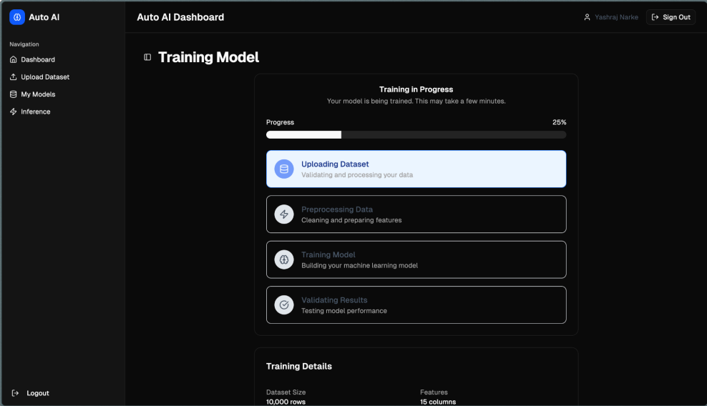
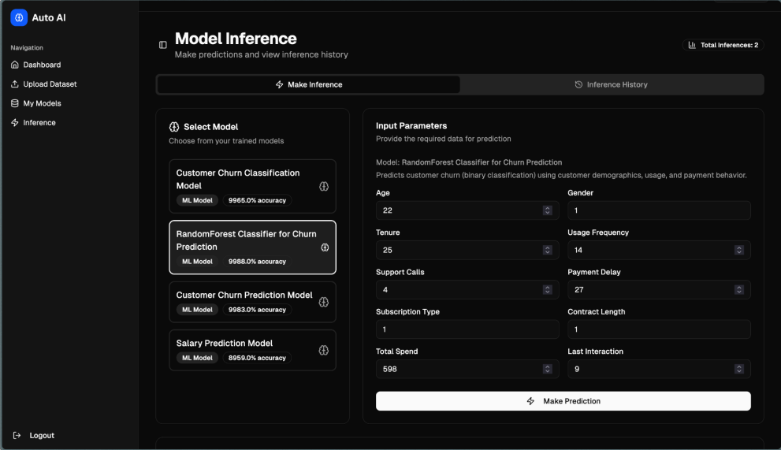
Working Demo

Slide 8

Q/A

